Slide 1

Staatsbibliothek zu Berlin – PK
Is this really relevant? Browser-based Testing for Enhancing Search results collaboratively
Paterson / Kaufmann
Notes:
Konkreter Eindruck, wie ich damit arbeite; Vorteile / Nachteile

Slide 2


Working With Git and Cypress for the First Time (as a Librarian): This is awesome!
don‘t have to do it all alone!
I can actually see (side) effects!
can travel back and forth in time!
all versions of yaml are safe!
this is all very exiting!
"Rudi ist begeistert" by stanzebla is licensed under CC BY-SA 2.0.
Notes:
Alone meaning: run 80 search queries manually and compare all (!!!) of the result lists to see what has changed and check for side effects. The complexity is baffling (at least to me)
Versionizing the yaml and how to handle it was an unsolved issue: only idea was saving the yaml after each change….. Which I‘m aware probably sounds ludicrous to this audience….
Plus I was really eager to enter the mysterious realm of Git and kinda „graduate“ to more developer-like work process.

Slide 3
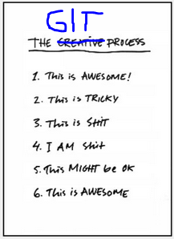

Test-Driven Development as a Newbie (and Librarian): This is Tricky IT Stuff
The biggie Git: getting my head around workflow and branches-multiverse; getting lost time and again
Cypress: wait, what? Reading and interpreting test failures
Notes:
Circling through the stages (see right) on a regular basis
Message: if you‘re an administrator you need to support getting started and teach Git; and permanent support;

Slide 4


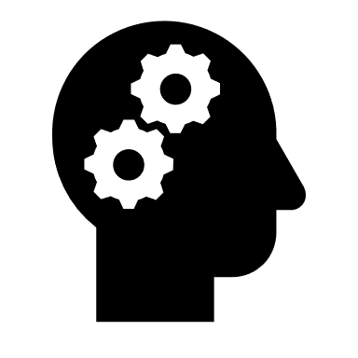
Test-Driven Development as (a Newbie) and Librarian: This is … … hard Culture Clash
formalizing requirements
iterative progress
trust the process?
facts are hard, opinions are easy
"Good versus Evil" by kosmolaut is licensed under CC BY 2.0.
Notes:
manual searches and interpretation of hit lists : personal, „intellecutal“, seems more „hands-on“, controllable, reproducible and traceable – it‘s what librarians are used to.
Automated tests and looking at green checks and red crosses by comparison seems technocratic, like loss of control and kind of externalised. I don‘t feel there‘s trust in the tests doing their job
While in effect it‘s the other way round. Failure to get across the advantages, nay: the NECESSITY for test-based ranking development: 82 search queries
Side effects seem not to be differentiated from work to fulfill ranking demands.
automated tests versus manual searches
test results versus interpretation of hit lists
Big Issue: Präzisierung: Anforderung; Reproducible (-> Duncan)

Slide 5
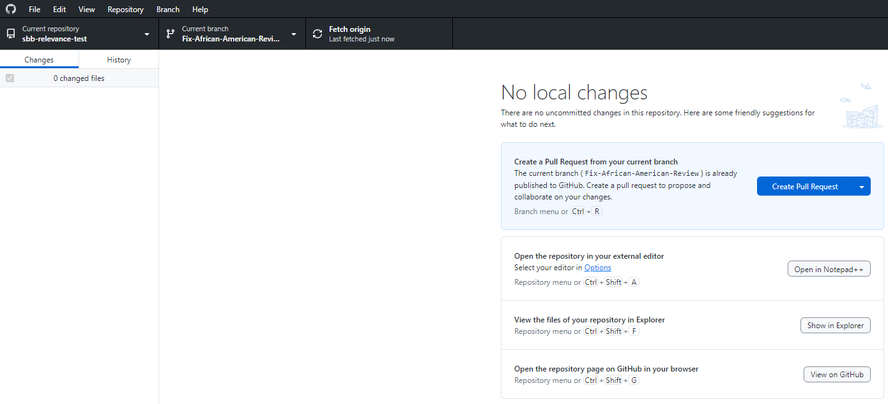
Working With Git and Cypress for the First Time (as a Librarian): I am … … confused

Slide 6
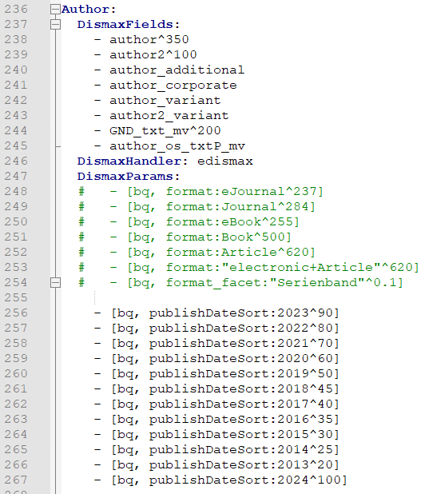
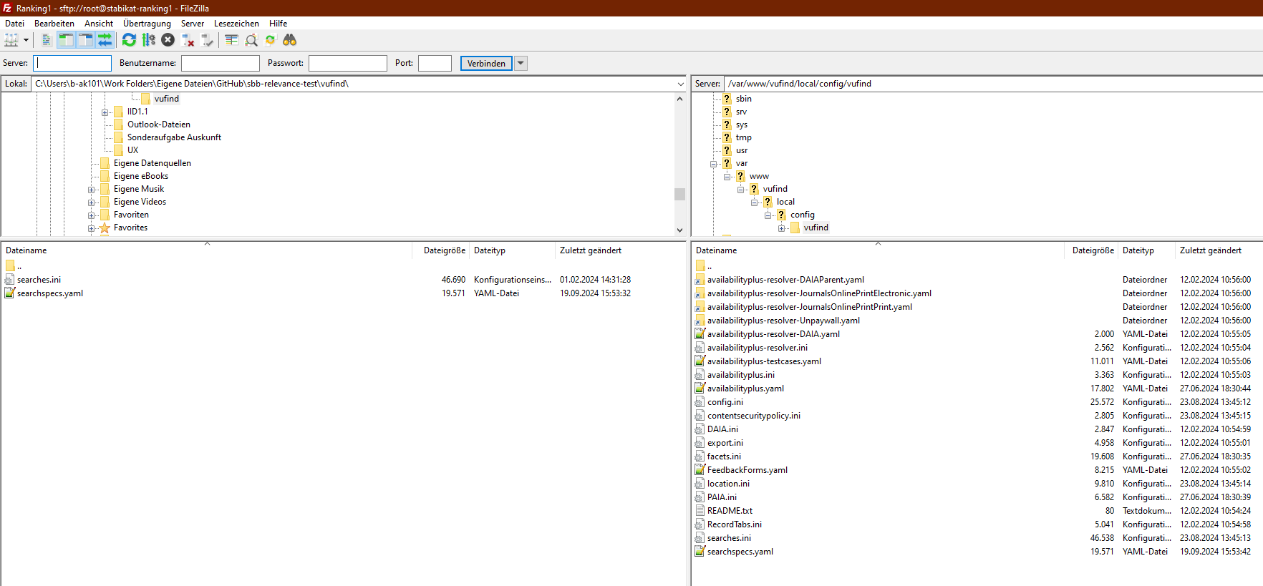
Working With Git and Cypress for the First Time (as a Librarian): I am … … confused

Slide 7
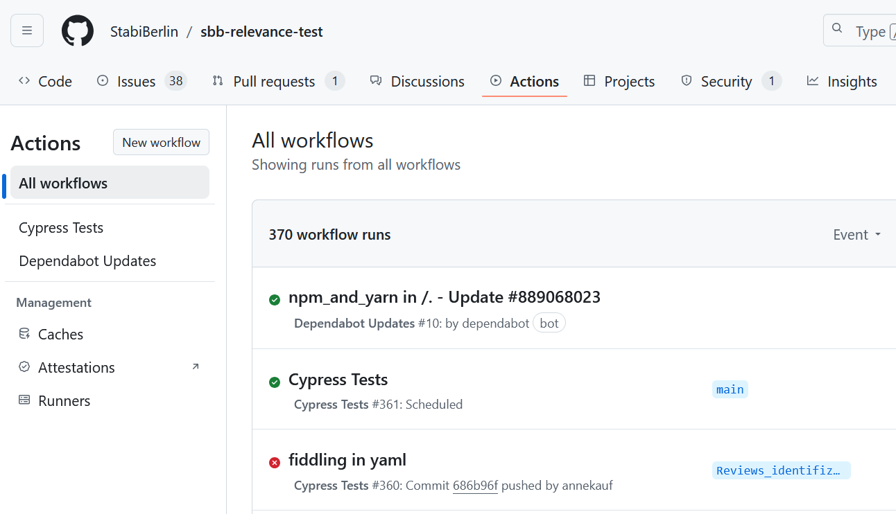
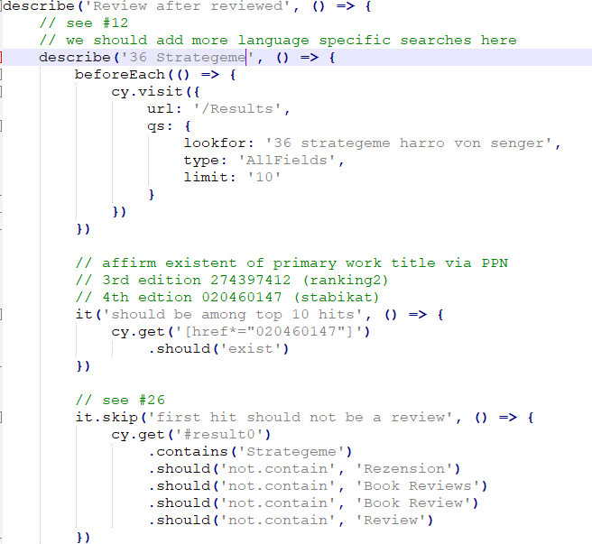
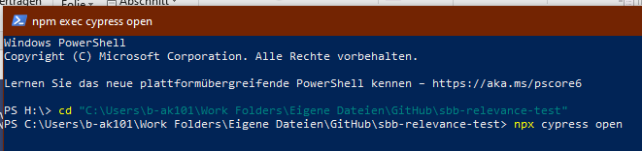
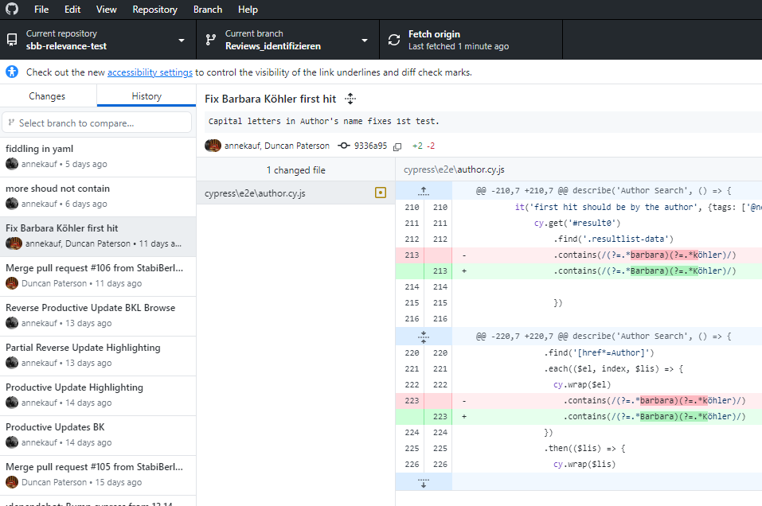
Working With Git and Cypress for the First Time (as a Librarian): I am … … confused

Slide 8
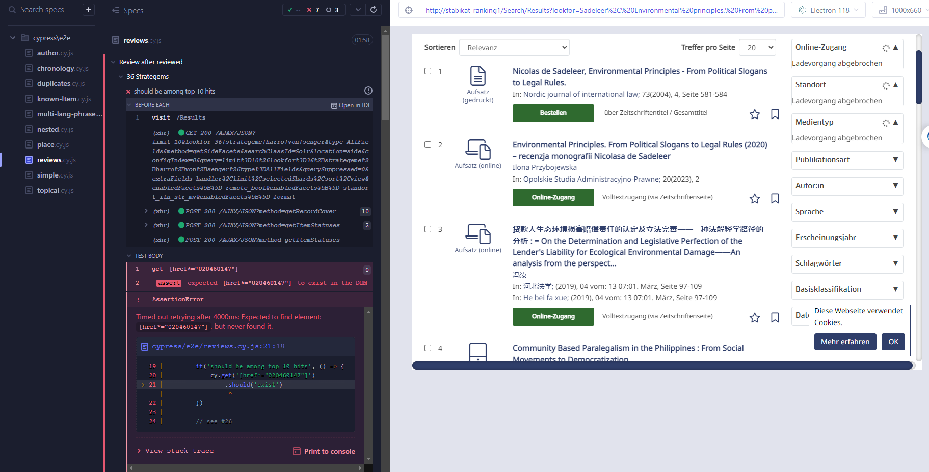
Working With Git and Cypress for the First Time (as a Librarian): I am … … confused

Slide 9
Working With Git and Cypress for the First Time (as a Librarian): I am … … confused

Slide 10

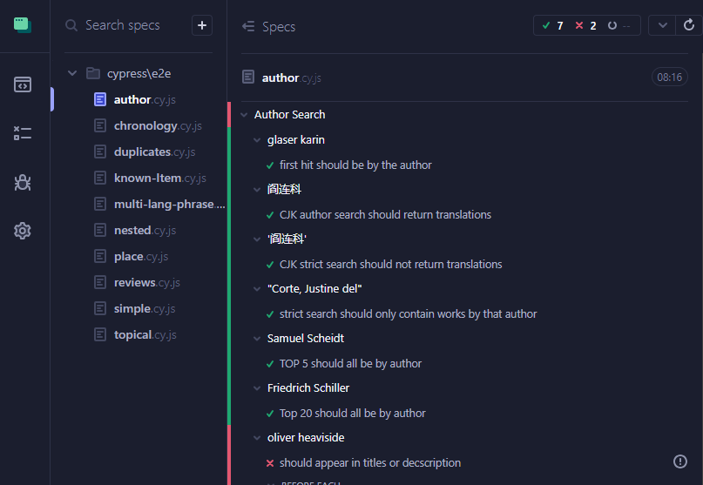
Working With Git and Cypress for the First Time (as a Librarian): I am … … confused
"Shock Shock Horror Horror" by Jeremy Brooks is licensed under CC BY-NC 2.0.

Slide 11
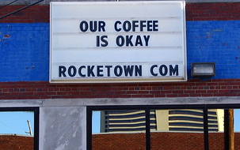
Test-Driven Development as a Newbie (and Librarian): This Might be Okay
managing expectations: what yaml can and can‘t solve re: VuFind result list
getting to grips with Git (more or less)
explaining work process to colleagues
„comes at a price“
there‘s no such thing as a perfect yaml = perfect ranking
"Our Coffee is Okay" by SeeMidTN.com (aka Brent) is licensed under CC BY-NC 2.0.
Notes:
Yaml can‘t solve duplicate problems; can‘t solve „wrong authors“ in result list („Barbara Köhler“) ; hard to have chronology ranking and at the same time disciminate reviews (Review problem / UX)
Comes at a price:
yaml is not a jack-of-all-trades device; conflicting demands (s. above) may not be able to be both met
The goal and result can only ever be an okay yaml (difficult for perfectionists to accept)

Slide 12
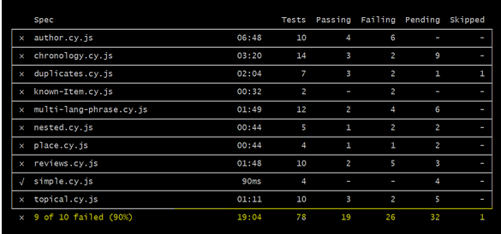
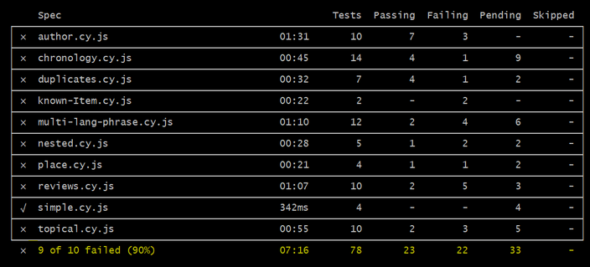

Slide 13
Working With Git and Cypress for the First Time (as a Librarian): This is awesome!
have learned so much!
travel back and forth in time!
all versions of yaml are safe!
can actually see (side) effects!
track progress (accurately)
Clear definition of goal
Collaborative yaml-work is easy!
"Rudi ist begeistert" by stanzebla is licensed under CC BY-SA 2.0.
Notes:
New on this slide:
track progress
Clear definition of goal
-> progress: more green tests
-> clear goal: all tests are green
This all gives security and clarity
Collaborative work is easy – now many people could work on improving yaml-ranking

Slide 14

The Frontier (to be pushed forward in the future?)
Git makes stuff clear: decision is in main - this doesn‘t translate into library management structure
how to integrate CICD practices into librarians everyday work
evolution from Excell-sheet to world-wide publication: transparency is scary
discovery system users become contributor/contributress
user research-based decisionmaking
"c'era una volta il west.....once upon a time in the west...." by betbele is licensed under CC BY-NC-SA 2.0.

Slide 15
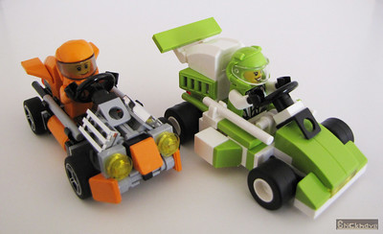
https://github.com/StabiBerlin/sbb-relevance-test
Duncan.paterson@sbb.spk-berlin.de
Annette.kaufmann@sbb.spk-berlin.de
"Microkarts: Orange versus Lime" by Bricknave is licensed under CC BY-NC-ND 2.0.

